Slide 1
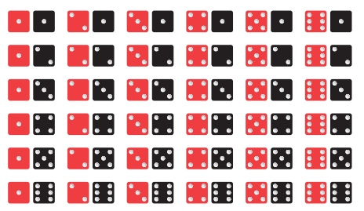
Miscellaneous Problems on Probability
Instructor
Osama Bin Ajaz
(osama.ajaz@nu.edu.pk)
Lecturer at FAST-NU, Main Campus

Slide 2
Transistors in a Box
Q9) A box contains 24 transistors, four of which are defective. If four are sold at random, find the following probabilities.
(a) Exactly two are defective
(b) all are defective
(c) none is defective
(d) at least one is defective.
Notes:
(a) P(X=2) = 1140/10626 (b) 1/ 10626 (c) 1615/3543=0.45582 (d) P(at least 1 d)=1927/3542

Slide 3
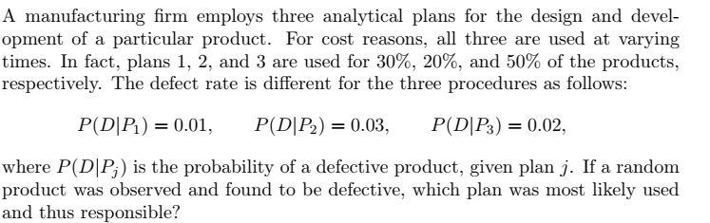
Which plan is responsible most for producing defects?
Notes:
P(P1|D)=0.158; P(P2/D)=0.316 P(P3/D)=0.526 since P(P3/D) is largest of the three, thus a defective is most likely the result of the use of plan 3

Slide 4
Speed Limits
Police plan to enforce speed limits by using radar traps at four different locations within the city limits. The radar traps at each of the locations L1, L2, L3, and L4 will be operated 40%, 30%, 20%, and 30% of the time. If a person who is speeding on her way to work has probabilities of 0.2, 0.1, 0.5, and 0.2, respectively, of passing through these locations, what is the probability that she will receive a speeding ticket?
Notes:
0.27 , theorem of total probability

Slide 5
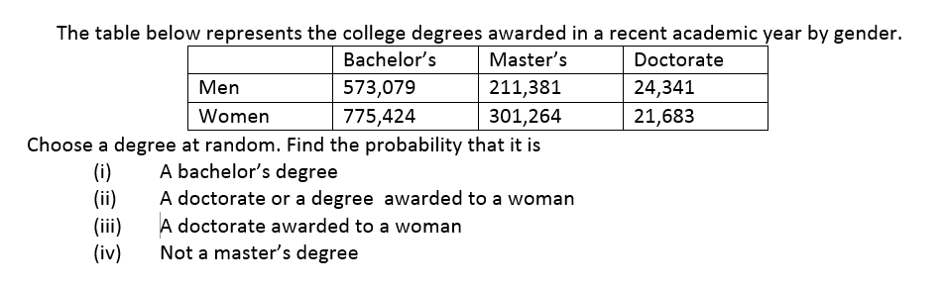
College Degree

Slide 6
Biased coin
A biased coin has the probability of flipping tails is ¾. Find the probability of obtaining at least one head when the coin is tossed five times.
Notes:
P(a head appears) = ¼ & P(no head or Tail appears) = ¾,
P(at least one head) = 0.763

Slide 7
Pair of Dice
A pair o of dice are thrown. Find the probability of getting a total of either 5 or 11?
Notes:
P(AUB) = 6/36 = 1/6

Slide 8
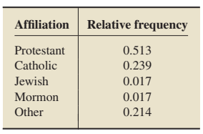
Religion in America
The U.S. Coast Guard maintains a database of the number, source, and location of oil spills in U.S. navigable and territorial waters. The following is a probability distribution for location of oil spill events.
Find the probability that the religious affiliation of a randomly selected U.S. adult is a. Catholic or Protestant. b. not Jewish. c. not Catholic, Protestant, or Jewish

Slide 9
365 Capsules
A total of 365 Capsules, each marked by the difference dates of the year, are mixed and one capsule is picked at random. What is the probability that the capsule picked will be of:
A day of January
March 2
Either of March or April
Not of December
Notes:
(i) 31/365, (ii) 1/365 (iii) 61/365 (iv) 334/365

Slide 10
Survey results for using Statistical software
A survey of those using a particular statistical software system indicated that 10% were dissatisfied. Half of those dissatisfied purchased the system from vendor A. It is also known that 20% of those surveyed purchased from vendor A. Given that the software was purchased from vendor A, what is the probability that that particular user is dissatisfied?
Notes:
P(S’) = 0.10, P(A/S’) = 0.5, P(A) = 0.2, P(S’/A) = (0.10)(0.5)/0.2 = 0.25

Slide 11
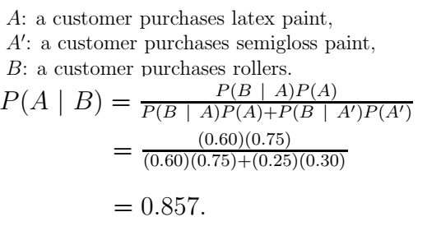
Latex Paint
A paint-store chain produces and sells latex and semigloss paint. Based on long-range sales, the probability that a customer will purchase latex paint is 0.75. Of those that purchase latex paint, 60% also purchase rollers. But only 30% of semigloss paint buyers purchase rollers. A randomly selected buyer purchases a roller and a can of paint. What is the probability that the paint is latex?

Slide 13
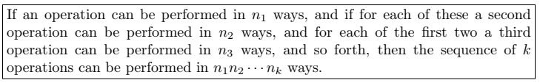
Multiplication Or Fundamental Rule of counting
How many sample points are there in the sample space when a pair of dice is thrown once?
How many there digit numbers can be formed from the digits 2, 4, 6, and 8 if: (i) repetitions are not allowed (ii) repetitions allowed
Notes:
(a) 36 (b) 24 & 64

Slide 14
Set of Example (iii - viii)
(iii) A developer of a new subdivision offers prospective home buyers a choice of Tudor, rustic, colonial, and traditional exterior styling in ranch, two-story, and split-level floor plans. In how many different ways can a buyer order one of these homes?
(iv) If a 22-member club needs to elect a chair and a treasurer, how many different ways can these two to be elected?
(v) Sam is going to assemble a computer by himself. He has the choice of chips from two brands, a hard drive from four, memory from three, and an accessory bundle from five local stores. How many different ways can Sam order the parts?
(vi) How many even four-digit numbers can be formed from the digits 0, 1, 2, 5, 6, and 9 if each digit can be used only once?
(vii) How many new arrangements can be made from the letters of the word FAVOUR so that vowel occupy even place.
Notes:
(iii) 12 ways (iv) 462 (v) 120 ways (vi) 156 (vii) 36
.

Slide 15
Permutation
A permutation is an arrangement of all or part of a set of objects.
The number of permutations of n objects is n!.
Suppose you have to arrange 3 books: Statistics, Maths, Physics on a shelf. How many arrangements are possible?

Slide 16

Permutations of “n” objects taken “r” at a time
In one year, three awards (research, teaching, and service) will be given to a class of 25 graduate students in a statistics department. If each student can receive at most one award, how many possible selections are there?
Notes:
25P3 = 13800

Slide 17
Example # 10:
A president and a treasurer are to be chosen from a student club consisting of 50 people. How many different choices of officers are possible if
(a) there are no restrictions;
(b) A will serve only if he is president;
(c) B and C will serve together or not at all;
(d) D and E will not serve together?
Notes:
(a) 2450 (b) 2401 (c) 2258 (e) 2448

Slide 18

Circular Permutations
The number of permutations of n objects arrange in a circle is (n –1 )!.

Slide 19
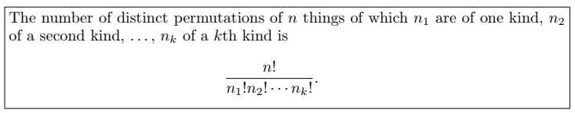
Permutations of n objects when they are not all different.
Find the number of permutations of 9995
In how many ways can the letters of the word STATISTICS be arranged?
In how many ways can 2 red, 3 blue, and 4 green chips be arranged in a row, if the chips of same color are not distinguishable from each other?
Notes:
(i) 4 (ii) 50,400 (iii) 1260

Slide 20
In a college football training session, the defensive coordinator needs to have 10 players standing in a row. Among these 10 players, there are 1 freshman, 2 sophomores, 4 juniors, and 3 seniors. How many different ways can they be arranged in a row if only their class level will be distinguished?
Notes:
12600

Slide 21

Combinations
Selection of “r” objects from “n” different objects and when the order is not important.
In how many ways a committee of 3 students can be selected from 4 students.
From a group of 10 boys and 6 girls a committee of 3 boys and 2 girls are to be selected. In how many ways can this done?
Notes:
(b) 1800 ways

Slide 22
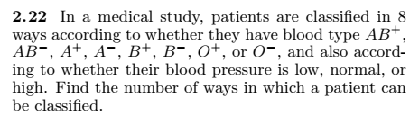
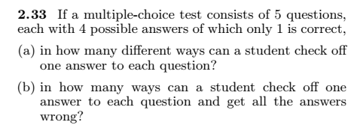

Exercises
Notes:
(2.22) 24 (2.33) (a) 1024 ways (b) 243 ways (2.37) 2880

Slide 23



Notes:
(2.45) 3360 (2.47) 8C3=56 ways (2.48) 365P60 = l=3.2e151

